Slide 1

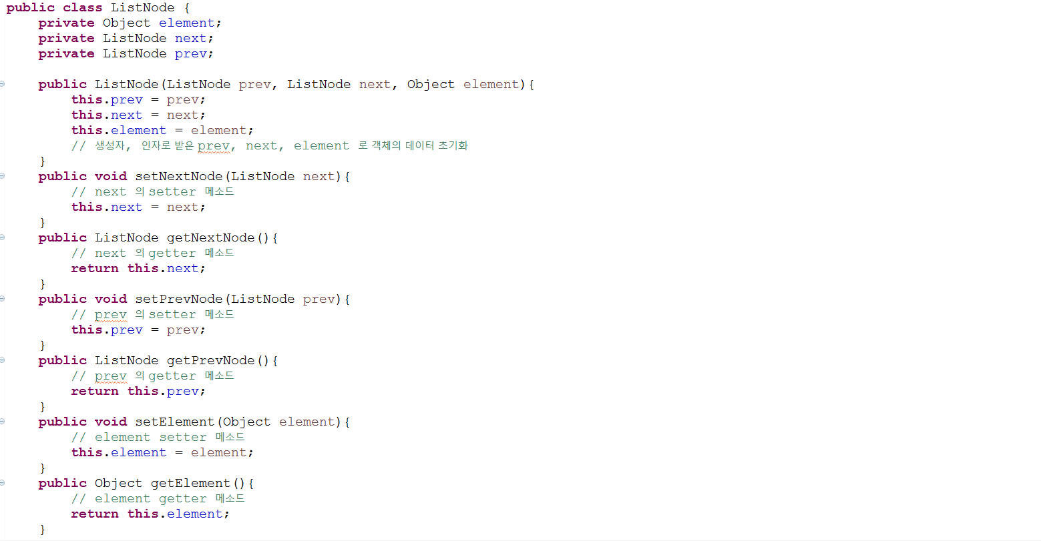
-ListNode

Slide 2
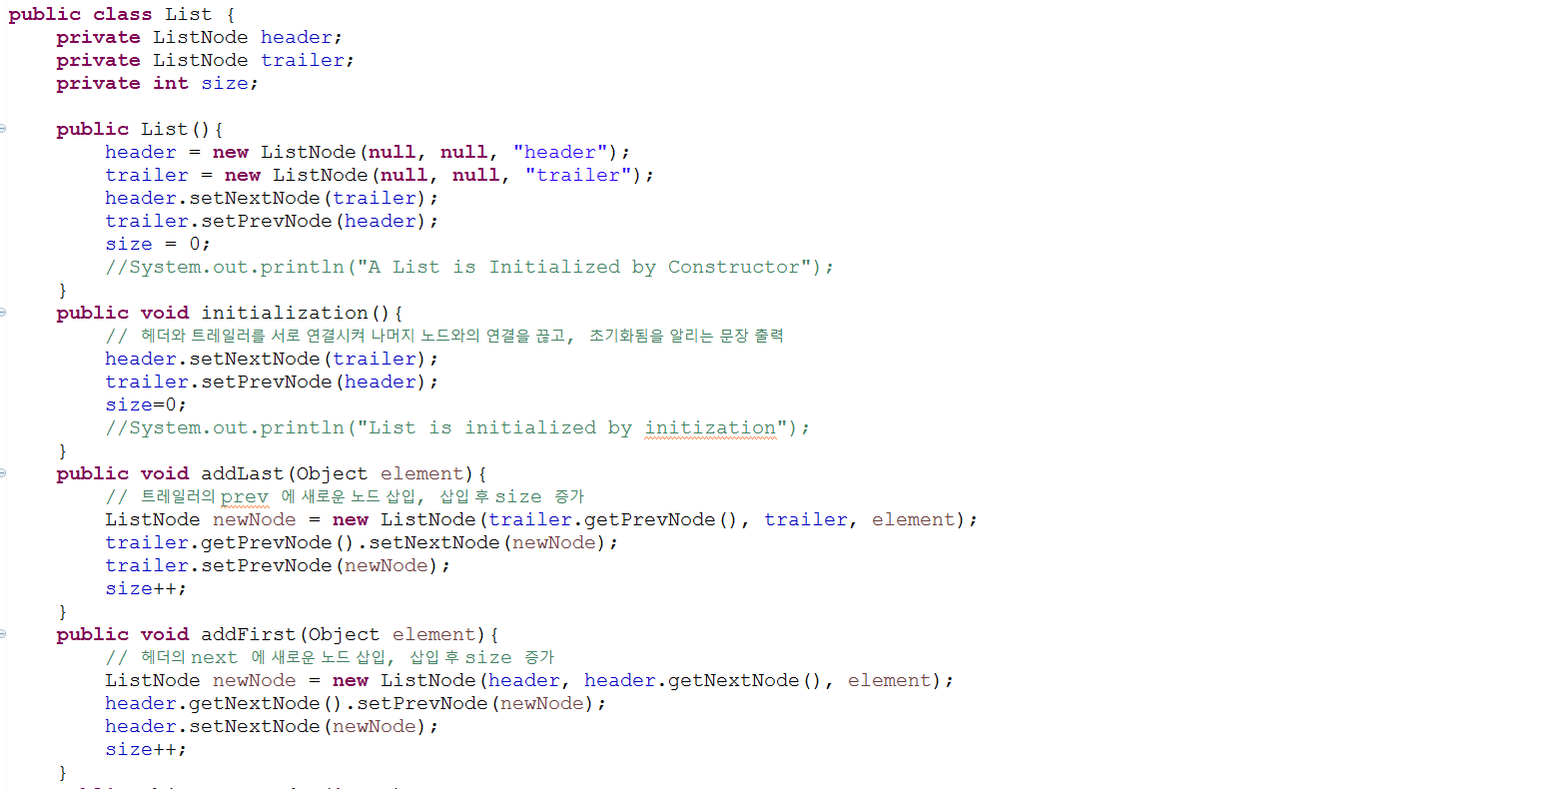
-List

Slide 3

-List

Slide 4
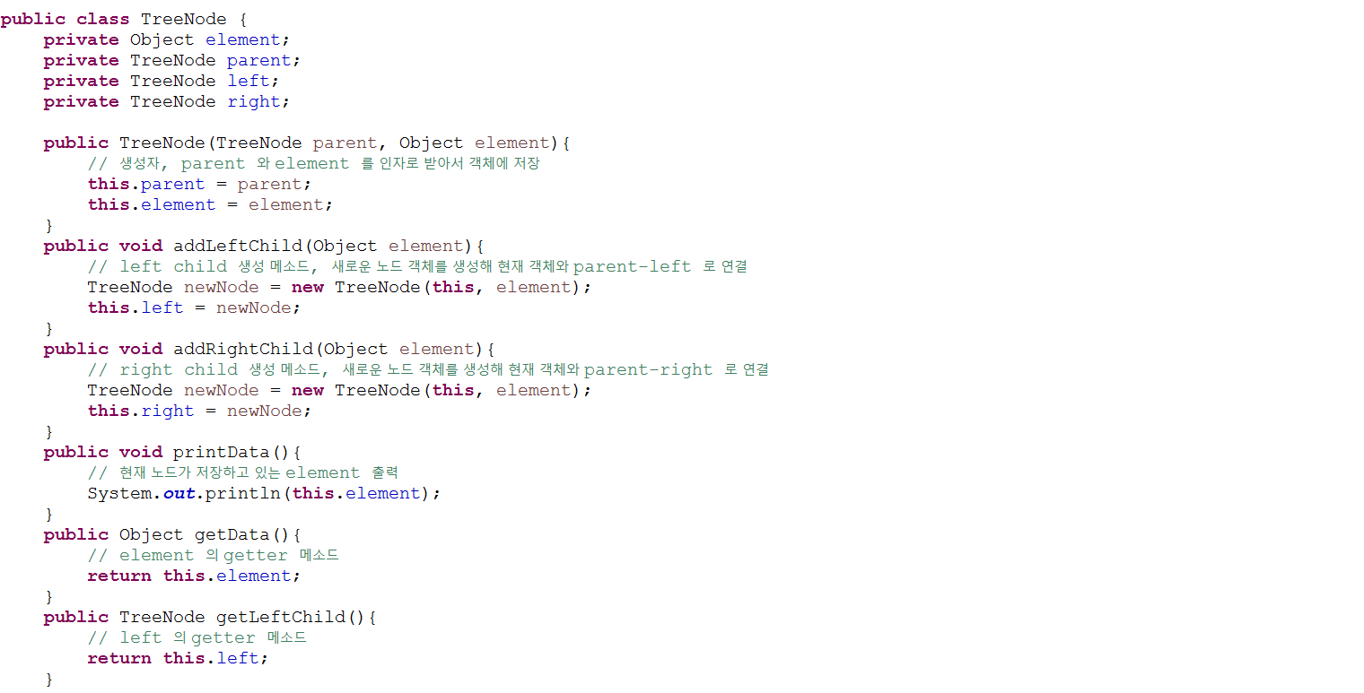
-TreeNode

Slide 5
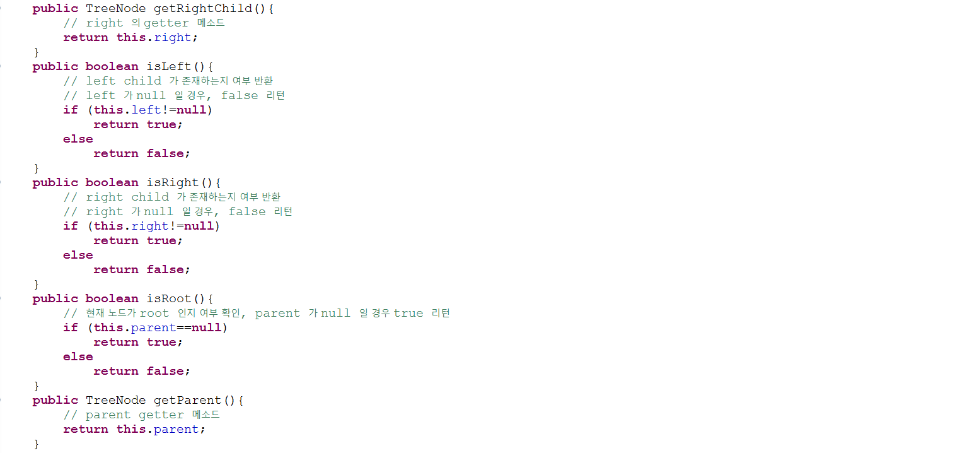
-TreeNode

Slide 6

-TreeNode

Slide 7
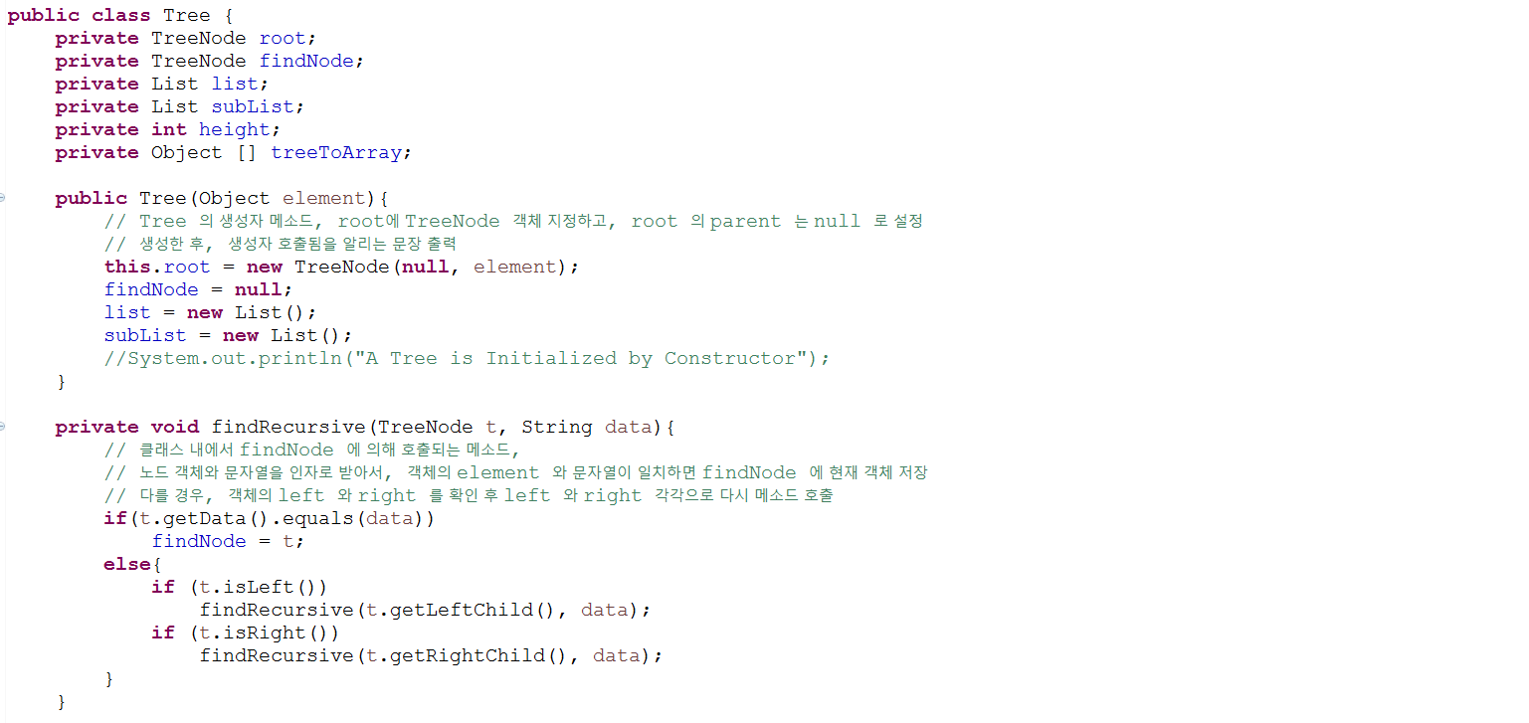
-Tree

Slide 8
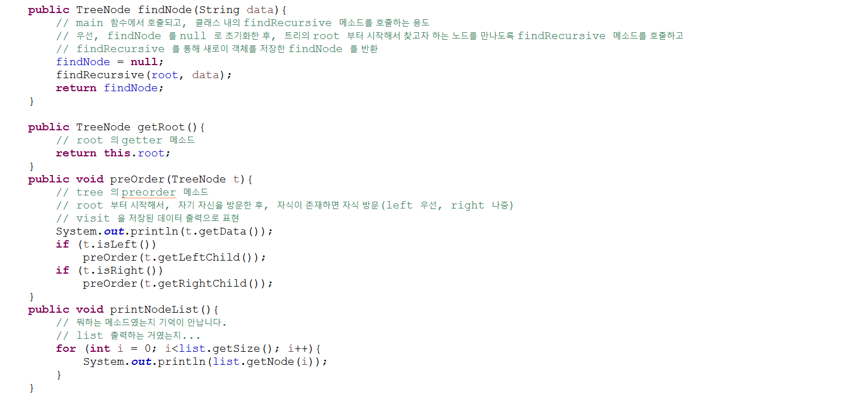
-Tree

Slide 9

-Tree

Slide 10
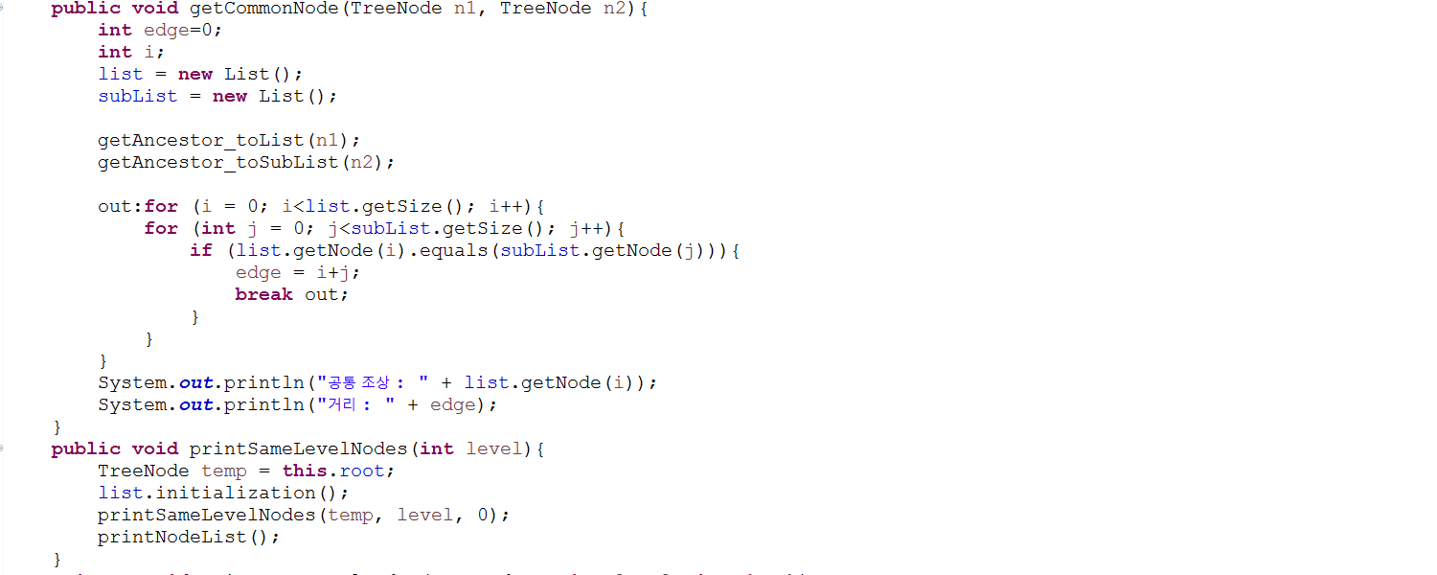
-Tree

Slide 11
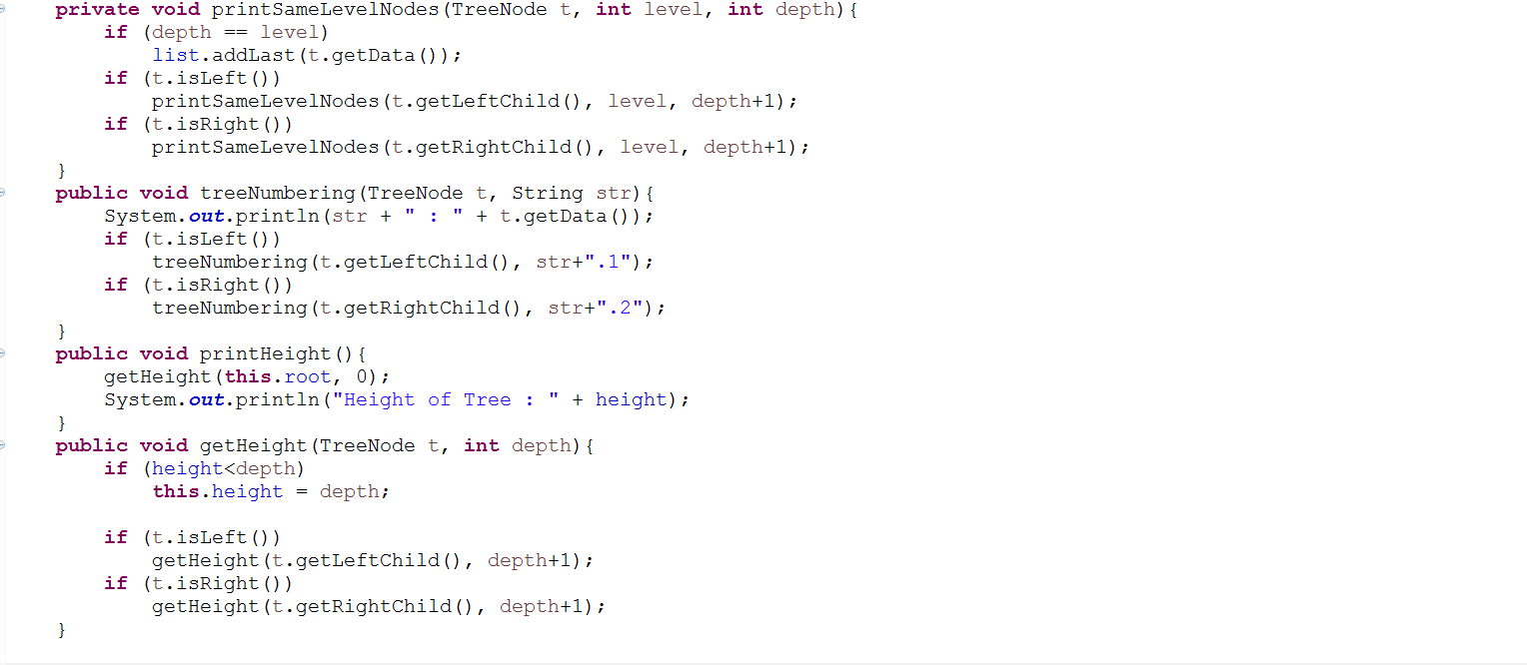
-Tree

Slide 12
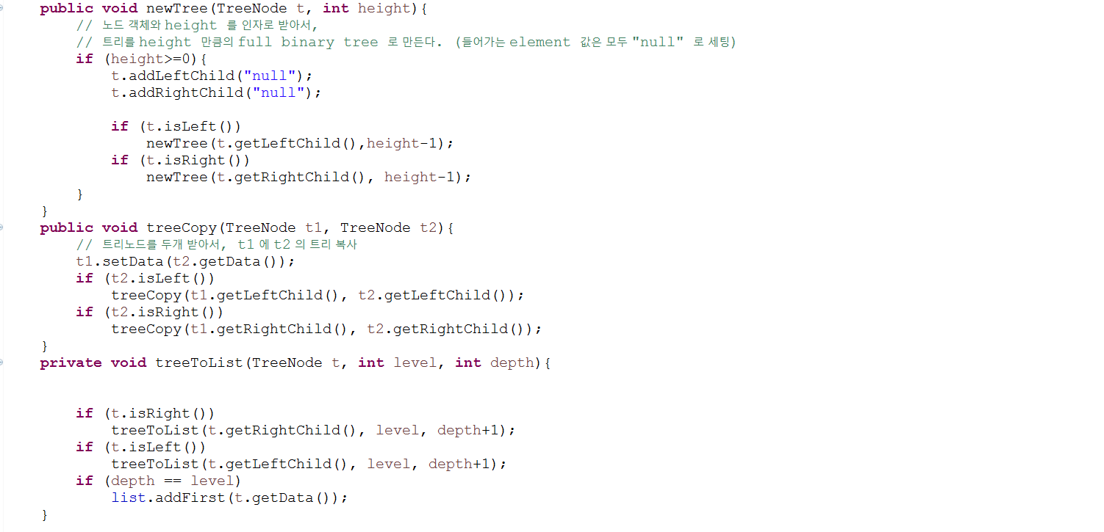
-Tree

Slide 13
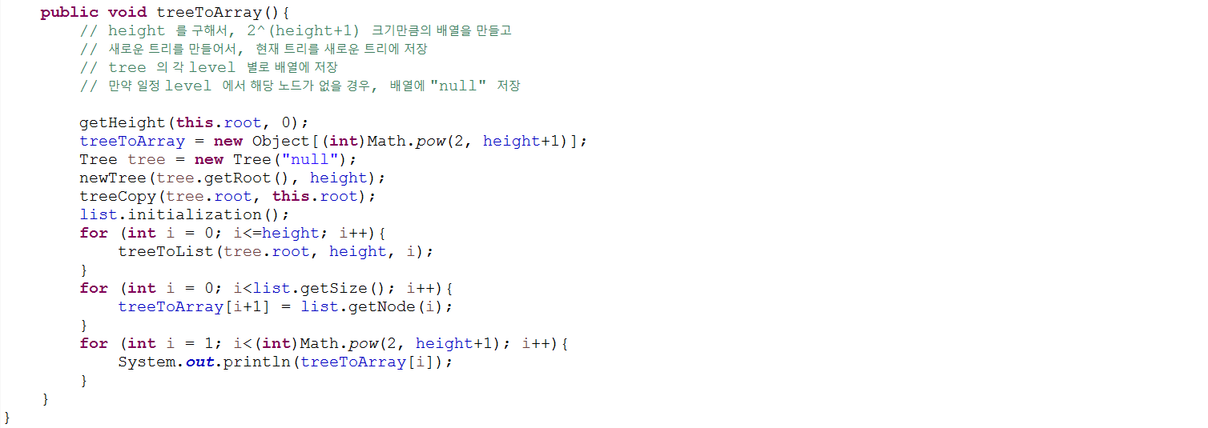
-Tree

Slide 14

